Slide 1
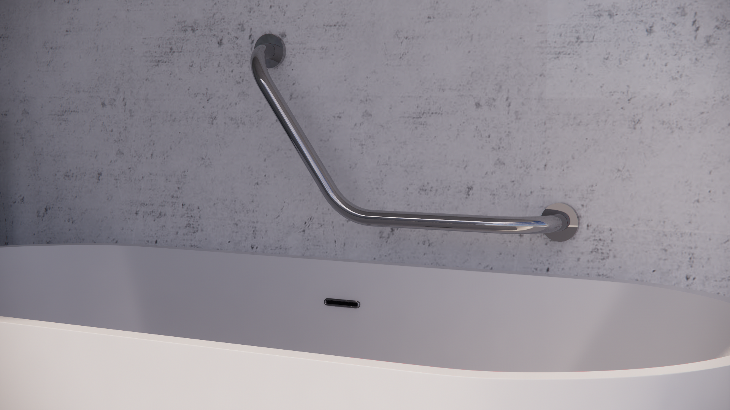
Insatllation guide
GB135V

Slide 2
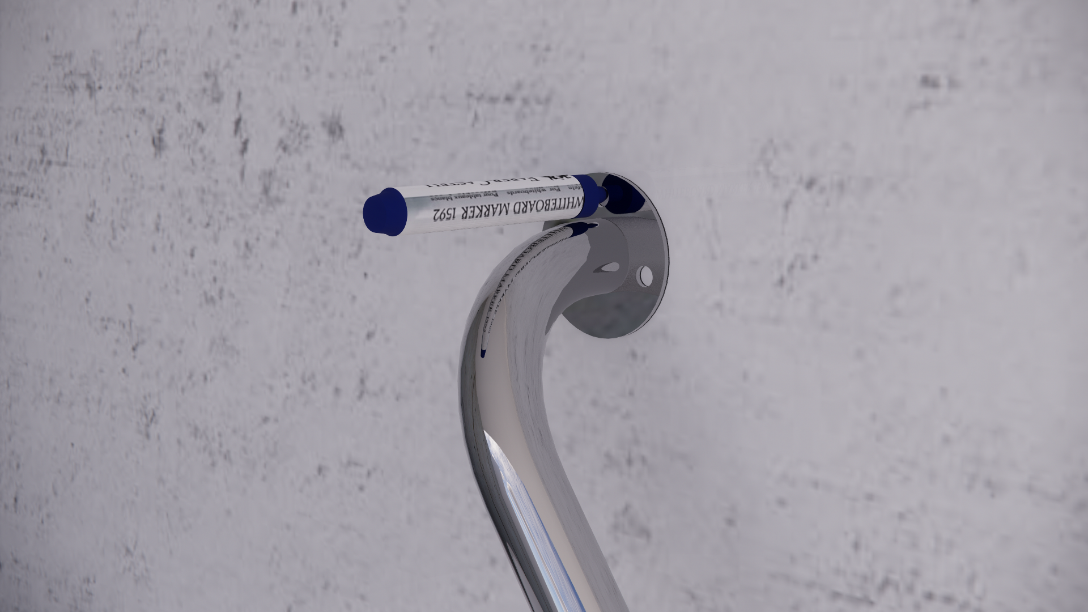
Set location & Mark
Use the marker to mark out the drill location

Slide 3
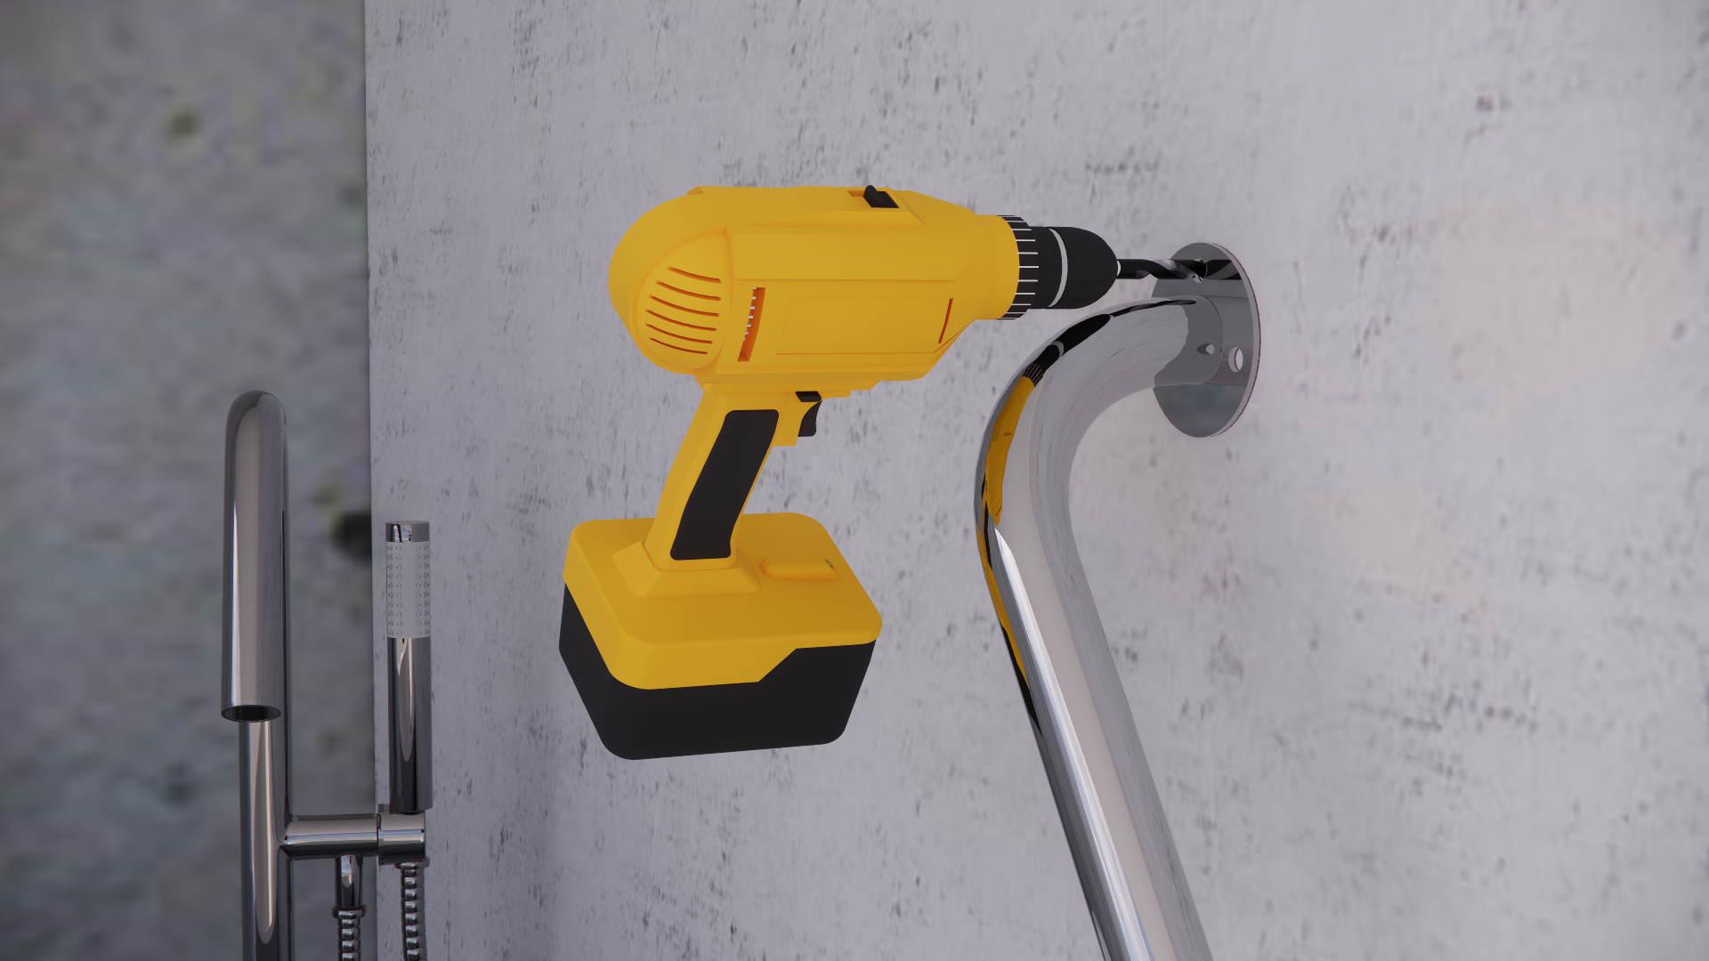
Drill holes
Use the M8 size Drill tool
follow the mark location
dill holes.
The depth of the hole deep enough
to the tread of the expansion screw.

Slide 4
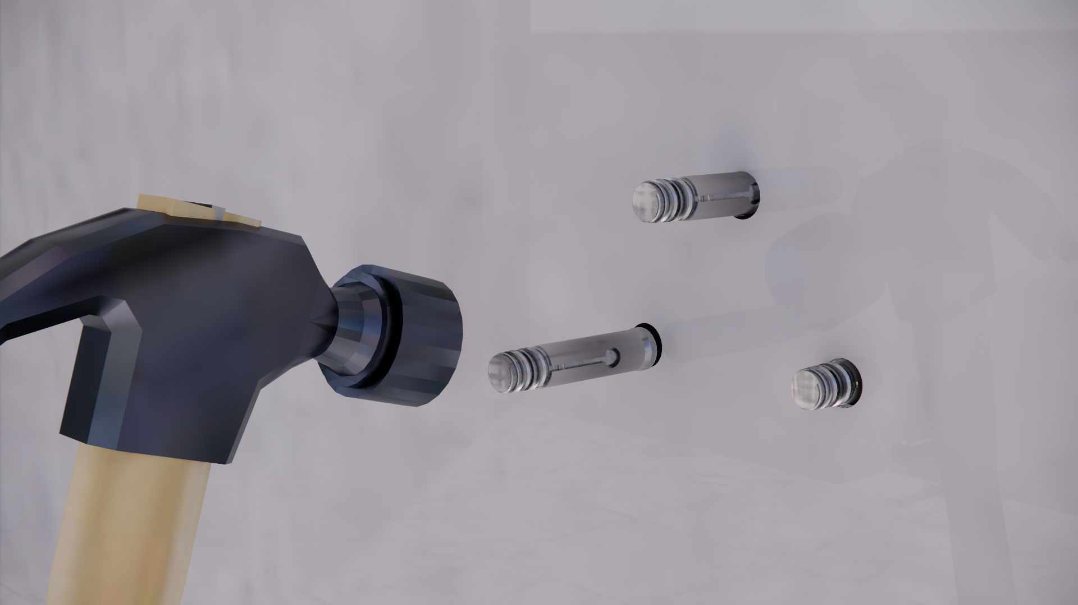
Hammer
Expansion pad
Insert the expansion screw & hammer it.
To make sure the expansion pad is fully in the wall, the screw thread is flat as wall level.

Slide 5
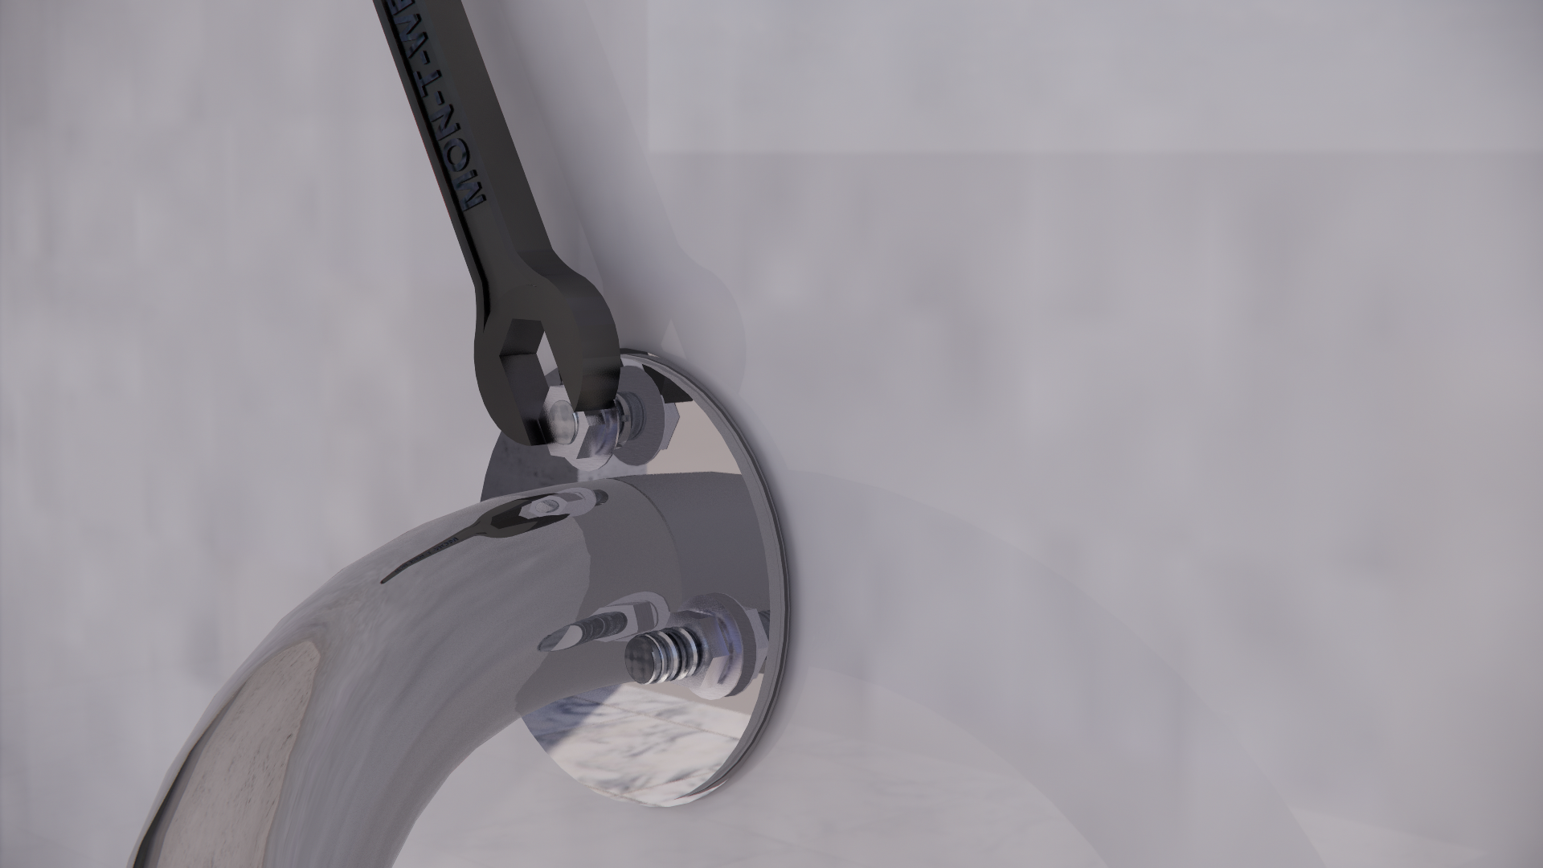
Tighten Bolts
use wrench to tighten the bolts

Slide 6
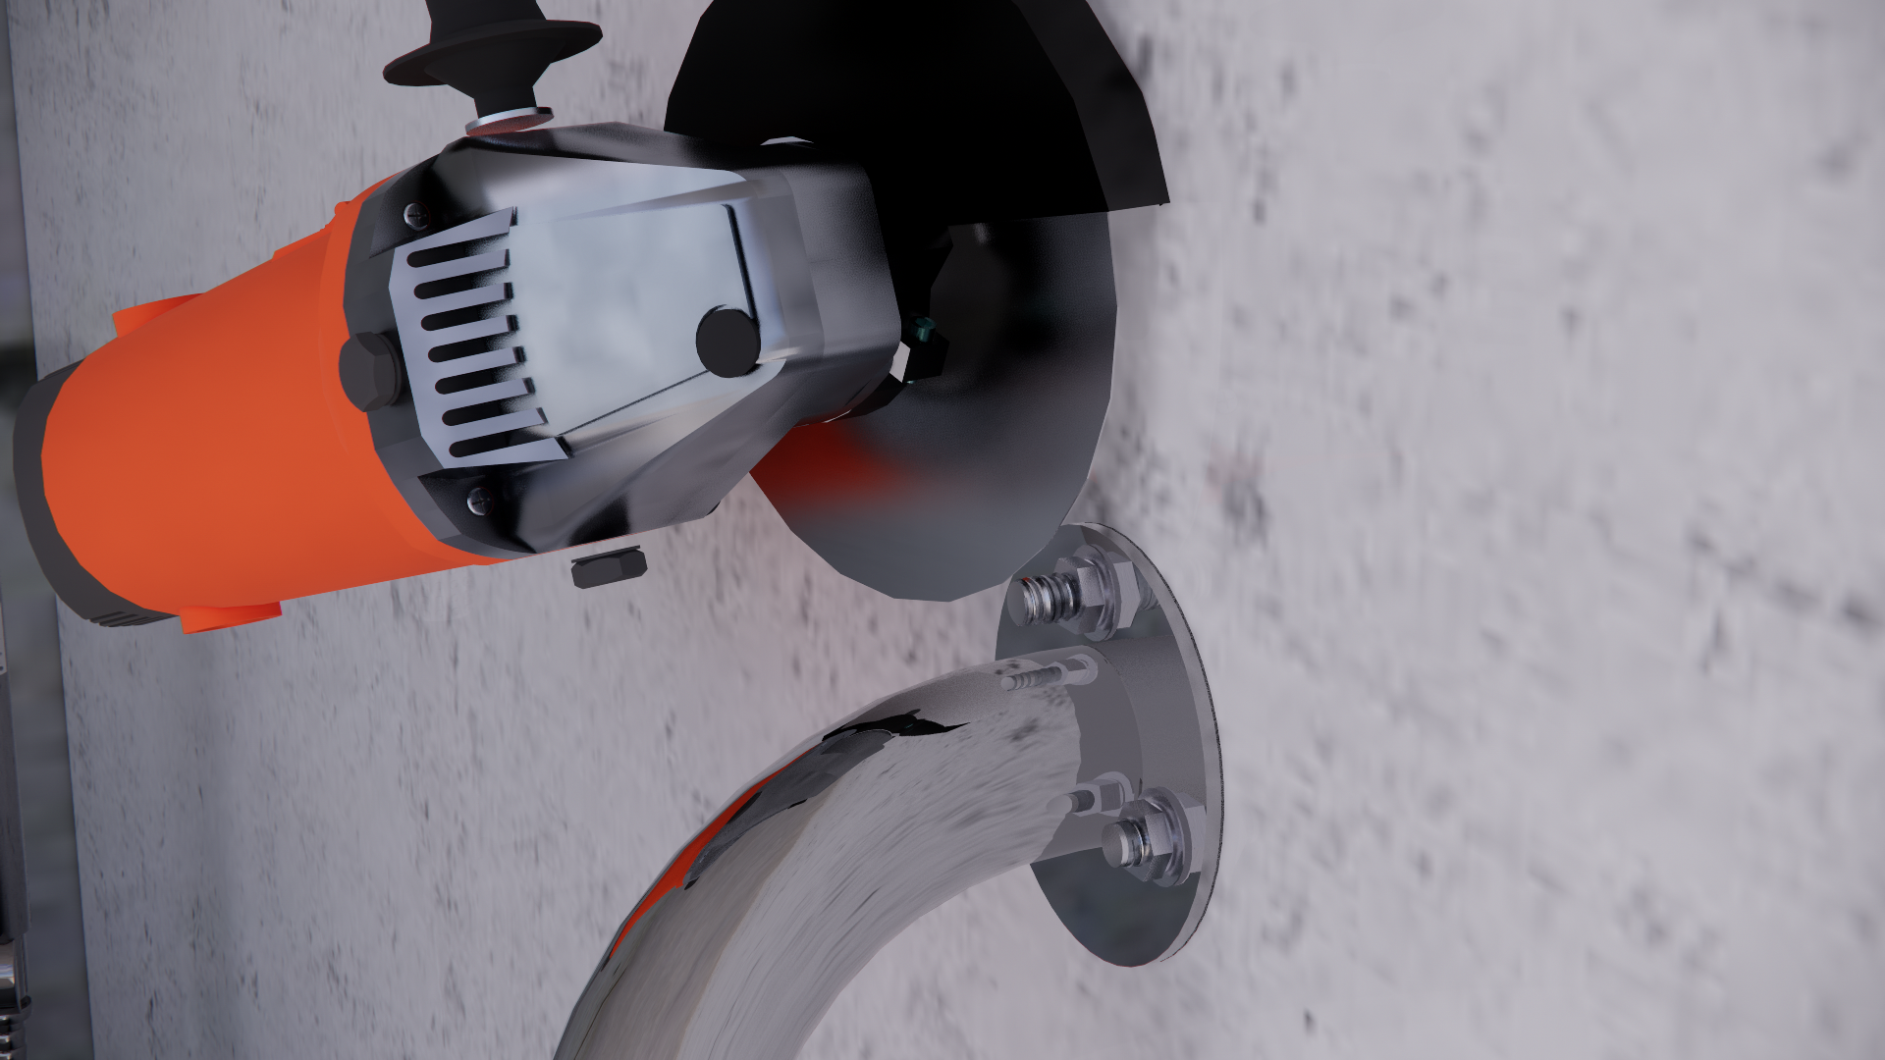
Cut
Use the flat grinder to cut off the excessively threads as flat as the bolt,
Using the cover to double check the height of the gap between cover and baseplate.
remove the rough edges of the screw after cut.

Slide 7
Finishined

